Slide 1
Introduction to DNA and DNA replication

Slide 2
Gene and Genomes
Basics of Genes
Genetics: Study of inheritance and inheritable traits as expressed in an organism’s genetic material
In the middle of the nineteenth century, Gregor Mendel formulated a set of rules to explain the inheritance of biological characteristics.
Each heritable property of an organism is controlled by a factor called a ‘Gene’.
Genes reside on chromosome and the functional unit of heredity
A gene consisted of DNA that coded for protein synthesis that performed the functions associated with the phenotypic expression of the gene.
Genome
The entire genetic complement of an organism
Includes its genes and nucleotide sequences

Slide 3
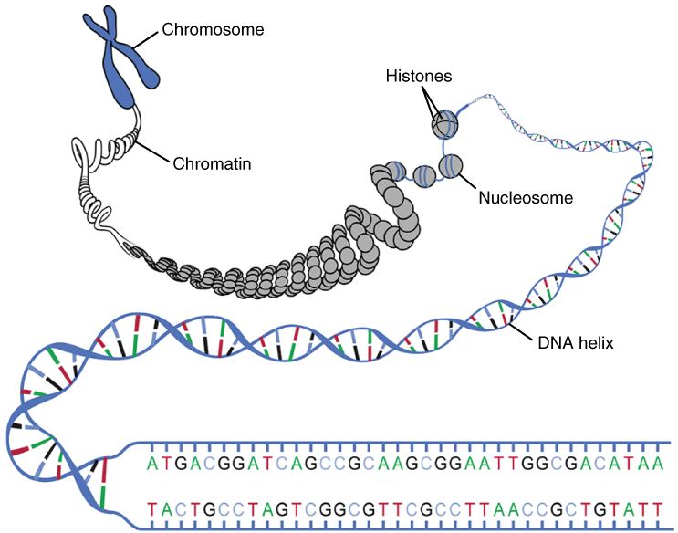
Chromosome and Genes

Slide 4
Basic Concepts
Gene
Contemporary understanding:
A segment on a DNA molecule
Usually at a specific location (locus) on a chromosome or plasmid
Characterized by its nucleotide sequence
Genes play three notable roles:
To encode the nucleotide sequences of mRNA, which in turn encodes the amino acid sequences of proteins
To encode the nucleotide sequences of tRNA or rRNA
To regulate the expression of other genes

Slide 5
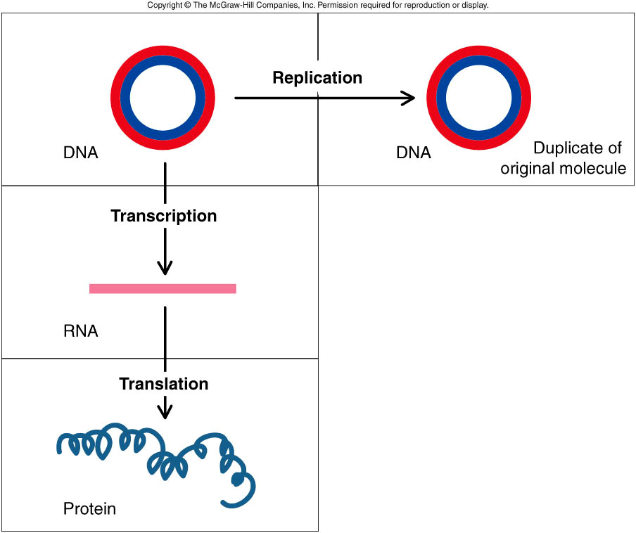
The central dogma of molecular biology

Slide 6
The store of the genetic information deoxyribonucleic acid (DNA)
DNA: the store of the genetic information deoxyribonucleic acid (DNA)
It is the principal regulator of the cell physiology
DNA contains the instructions for creation and functioning of the organism, it acts as
Template for replication
Codes for proteins

Slide 7
Composition of Nucleic Acids
• Nucleic acids are substances with high molecular weight ranging from 1,286 to 3,000,000 daltons (# of basepairs x 650 daltons).
They are made up of carbon, hydrogen, oxygen, nitrogen and phosphorus.
• Nitrogen is from 15 to 16% while phosphorus is from 9 to 10%.
On hydrolysis with either an enzyme or by heating with dilute acids or alkalies, nucleic acids yields a group of compound known as nucleotides.

Slide 8
DNA or RNA are called nucleic acids because of the acidic nature of the phosphate group attached to them.
The phosphate group is negatively charged because it donates protons in solution. An acid is identified by its ability to donate protons.

Slide 9
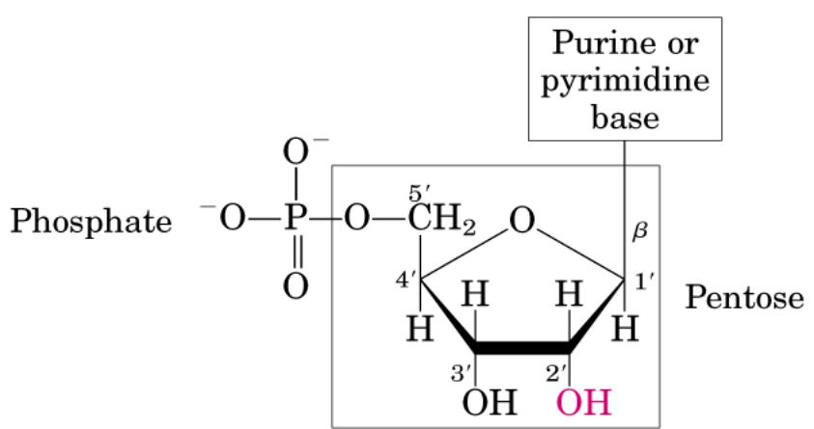
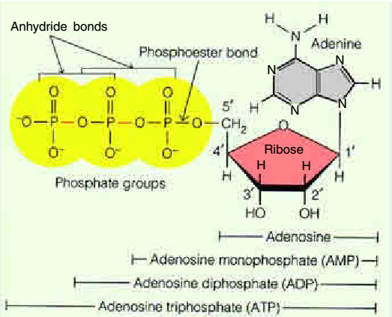
Nucleic acids
DNA and RNA are nucleic acids, long, thread-like polymers made up of a linear array of monomers called nucleotides
“Energy rich” compounds
Chemical signals
Enzyme co-factors
Nucleic Acids
DNA and RNA
Polymers of nucleotides
All nucleotides contain three components:
1. A nitrogen heterocyclic base
2. A pentose sugar
3. A phosphate residue
Without phosphate nucleotide is called as nucleoside
Nucleoside
Nucleotide

Slide 10
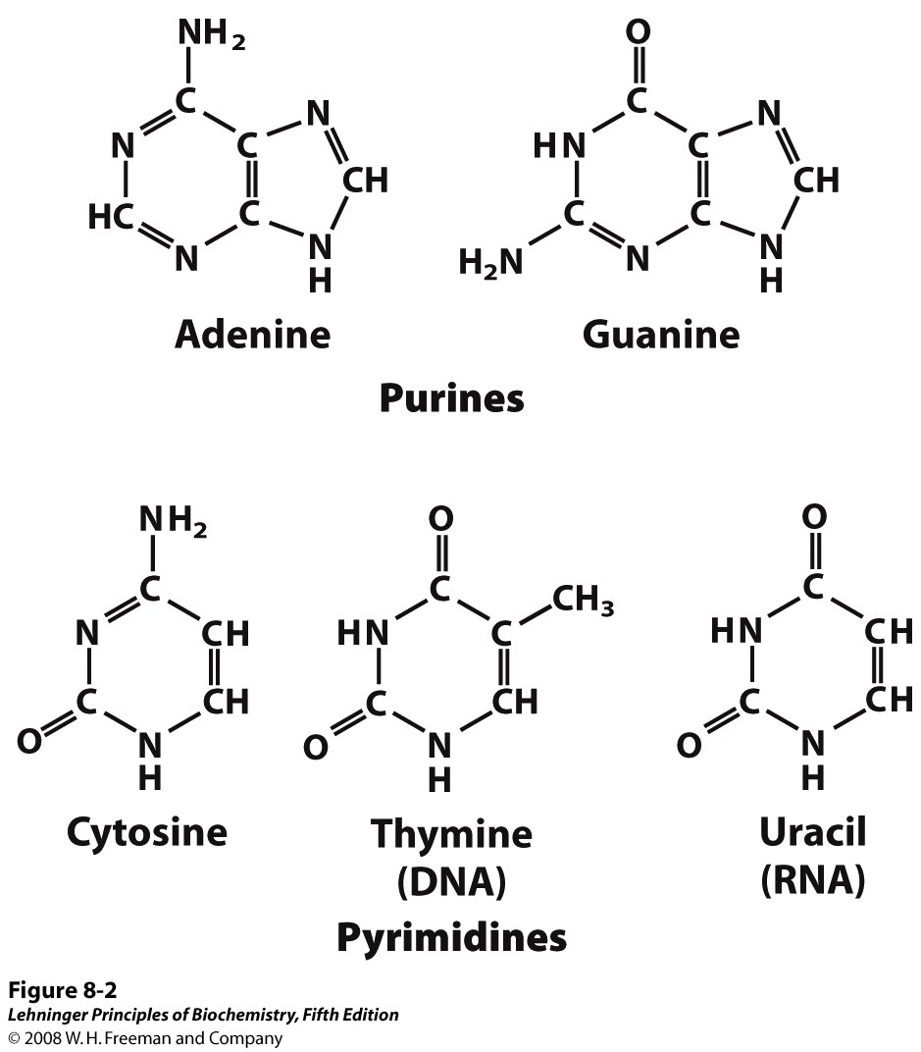
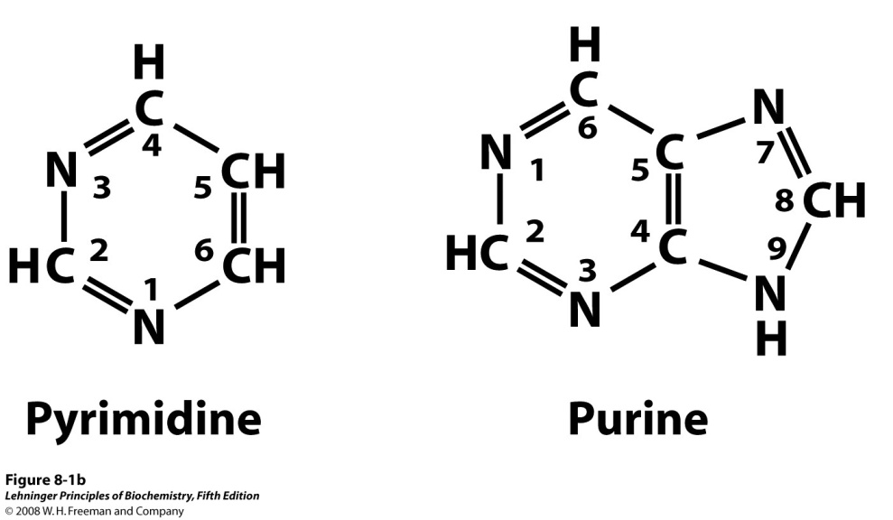
Nitrogenous bases
Purine bases
A G
Bases
Pyrimidine bases
C T U

Slide 11
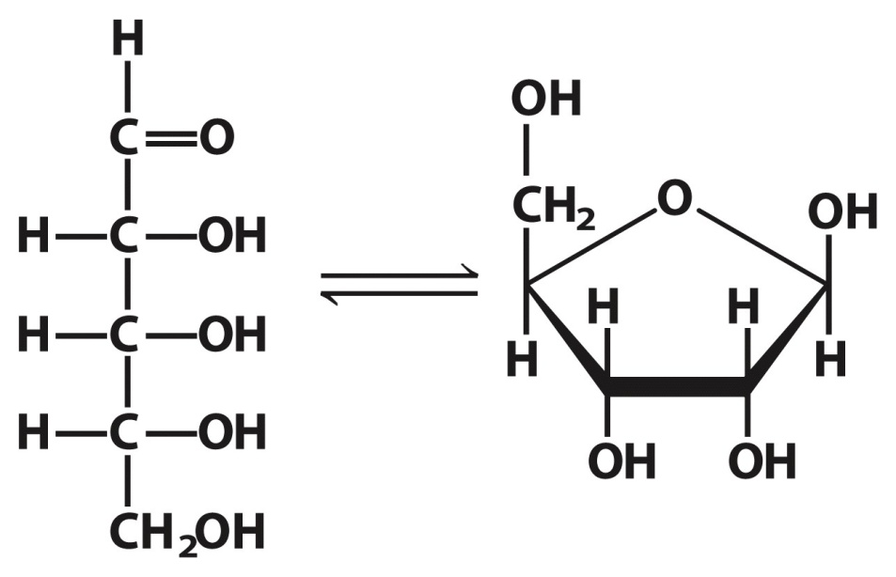
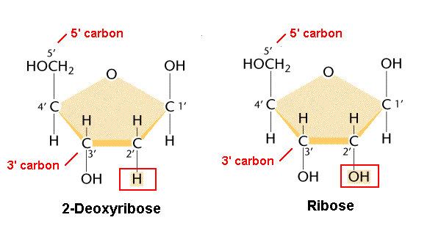
Ribose
Carbons numbered:
1’,2’,3’,4’,5’
DNA – 2’ Deoxyribose sugar
2’ deoxyribose – 2’ position
OH group is replaced by H
5’
1’
4’
3’
2’

Slide 12
DNA Nucleotide
Phosphate
Group
O
O=P-O
O
5
CH2
O
N
Nitrogenous base
(A, G, C, or T)
C⁴
C¹
Sugar
(deoxyribose)
C³
C²

Slide 13
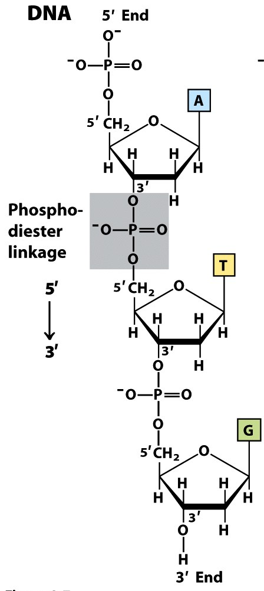
Polymer of Nucleotides
nucleotides can be linked
phosphates linked to 2 pentoses
phosphodiester linkages
Link PO₄ at
5’ end to 3’ OH of next nucleotide
chain has POLARITY
distinct ends
5’ end
3’ end
usually “read” 5’ -> 3’
5’end: always has attached phosphate groups
3’ end: free hydroxyl
(-OH) group

Slide 14
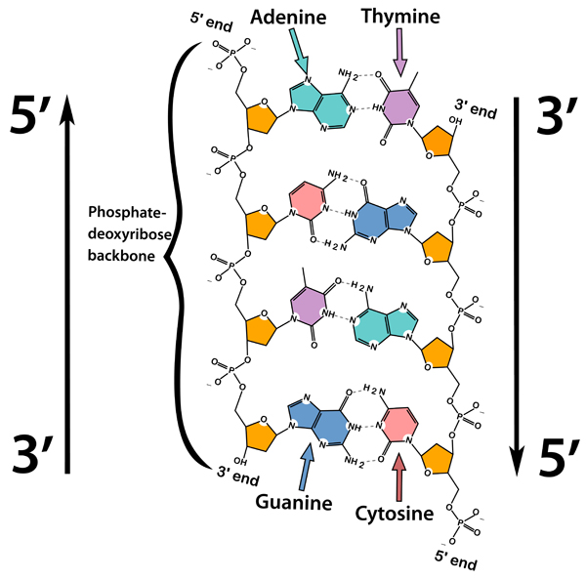
DNA strands are antiparallel and complementary
Essential for replicating DNA and transcribing RNA
Two separate strands Antiparellel (5’→3’ direction)
Complementary (sequence)
Base pairing: hydrogen bonding that holds two strands together
Sugar-phosphate backbones (negatively charged): outside
Planner bases (stack one above the other): inside
Notes:
Two streets with opposite traffic directions.. Two parallel spiral staircase with opposite traffic directions

Slide 15
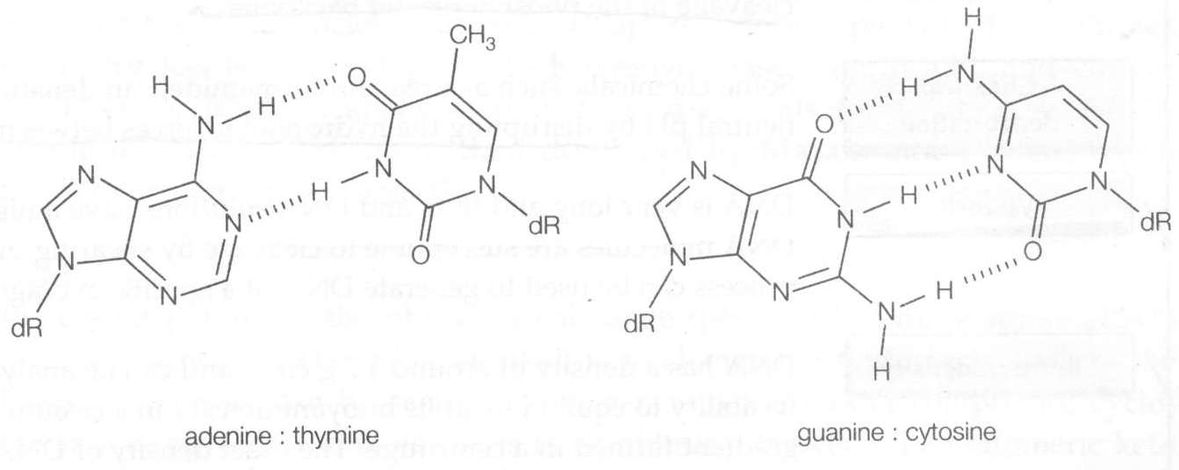
Base pairing
4
3
1
6
2
8
7
5
1
9
4
3
2
A:T
G:C
6-amino purine
2,4-dioxy-5-methyl pyrimidine
2 hydrogen bonds between A and T
3 hydrogen bonds between G and C

Slide 16
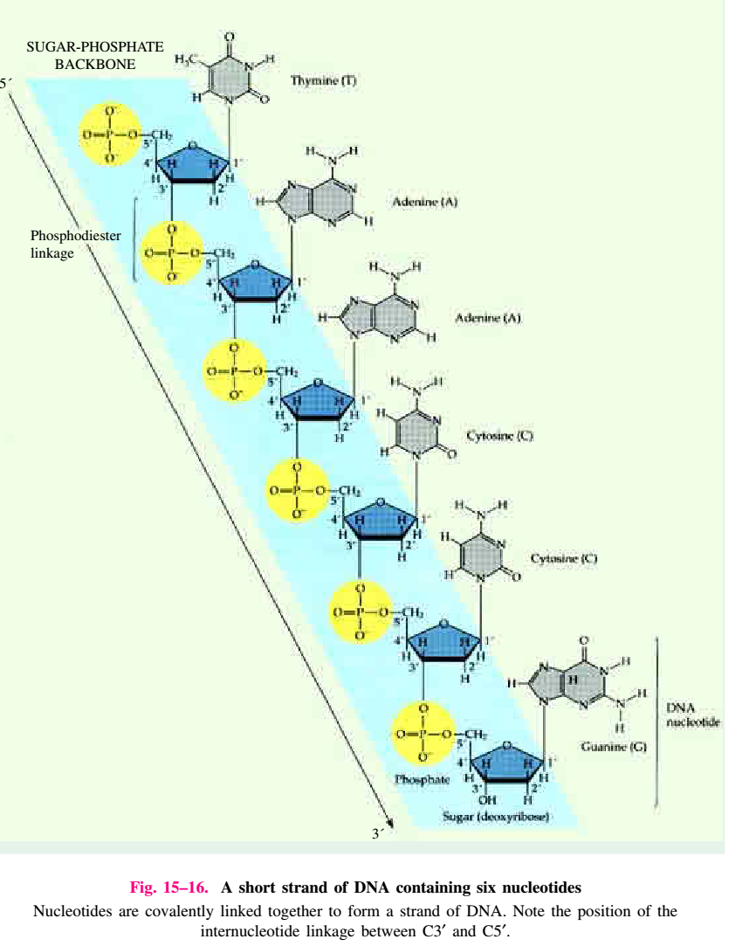
Sugar-phosphate backbone

Slide 17
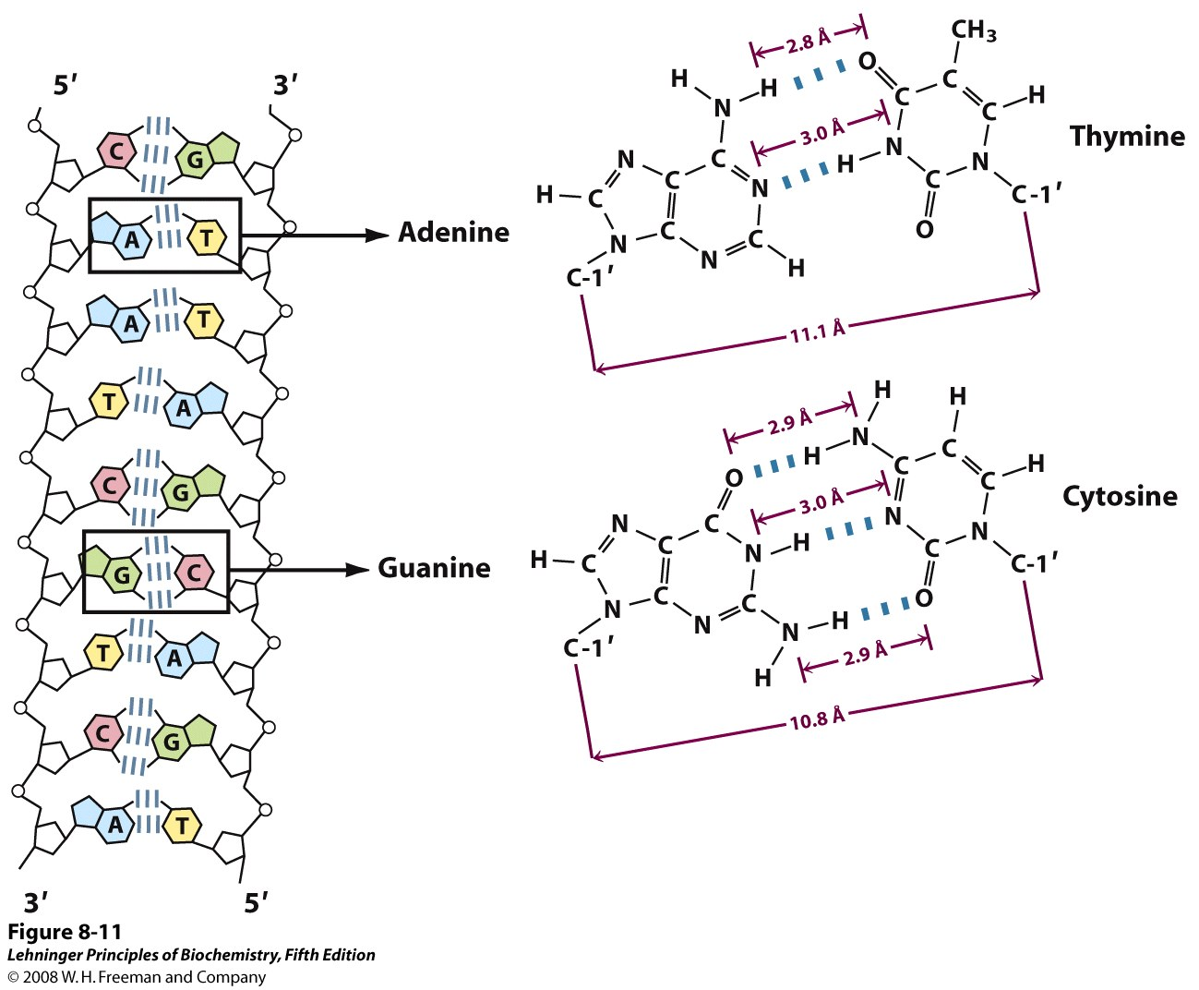
DNA is double stranded
DNA is a double stranded
Bases form a specific hydrogen bond pattern
6-amino purine
2,4-dioxy-5-methyl
pyrimidine
2-oxy-4-amino
pyrimidine
2-amino-6-oxy purine
G
C
T
A

Slide 18
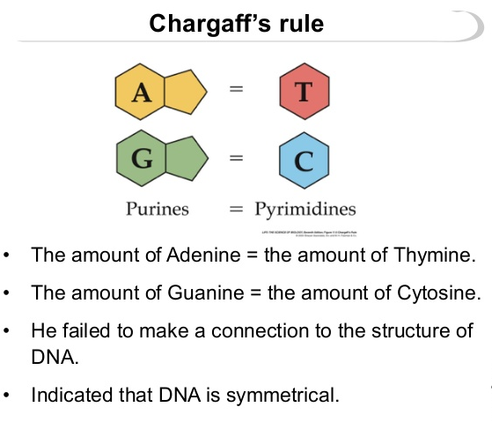
Chargaff’s rule (Rule of basepairing or equivalence rule)
The rules of base pairing (or nucleotide pairing) are:A with T: the purine adenine (A) always pairs with the pyrimidine thymine (T)
C with G: the pyrimidine cytosine (C) always pairs with the purine guanine (G)
The rules of base pairing explain the phenomenon that whatever the amount of adenine (A) in the DNA of an organism, the amount of thymine (T) is the same (Chargaff's rule). Similarly, whatever the amount of guanine (G), the amount of cytosine (C) is the same.
The C+G : A+T ratio varies from organism to organism among the prokaryotes
Chargaff's rules state that DNA from any cell of all organisms should have a 1:1 ratio (base Pair Rule) of pyrimidine and purine bases and, more specifically, that the amount of guanine is equal to cytosine and the amount of adenine is equal to thymine.

Slide 19
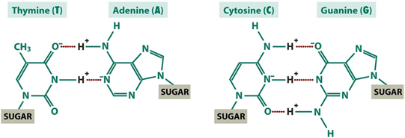
Chargaff’s rule (Rule of base pairing or equivalence rule)
In a given sample of DNA, the total amount of purines = total amount of pyrimidines (i.e. A+G = T+C)
The ratio of A:T = 1
The ratio of G:C = 1
A/T or G/C = 1
A=T, G=C
A+G = T+C (Number of AG pairs need to equal to number of TC pairs)
[A] = [T] and [G] = [C] therefore, [A]+[G] equals to [T]+[C]
A+T / G+C ratio varies with species
In humans, 30% A, 30%T, 20% G, and 20%C
In Escherichia coli 24% A, 24% T, 26%G, 26% C

Slide 20
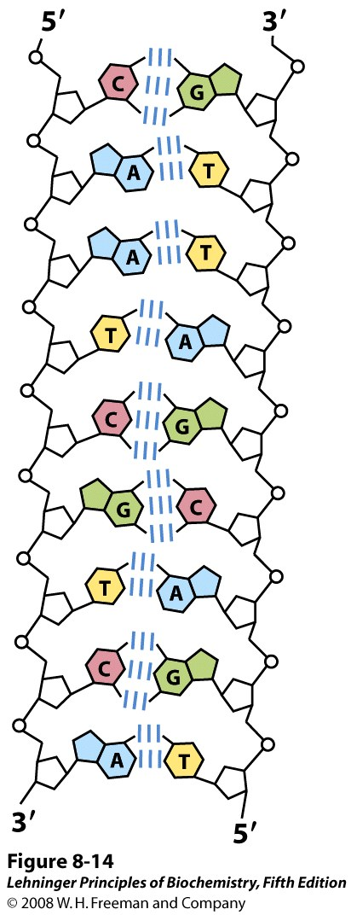
Properties of DNA double helix
The strands of DNA are antiparallel
The strands are complimentary
There are Hydrogen bond forces
There are base stacking interactions
There are 10 base pairs per turn

Slide 21
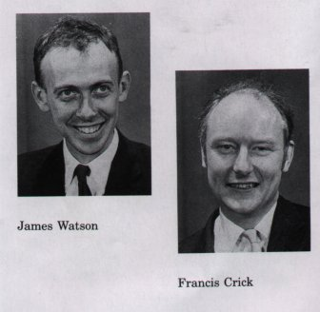
Watson and Crick – DNA double helix
Nucleic Acid Structure : DNA double helix
Watson and Crick , 1953
The genetic material of all organisms except for some viruses
The foundation of the molecular biology
Noble prize in 1962

Slide 24
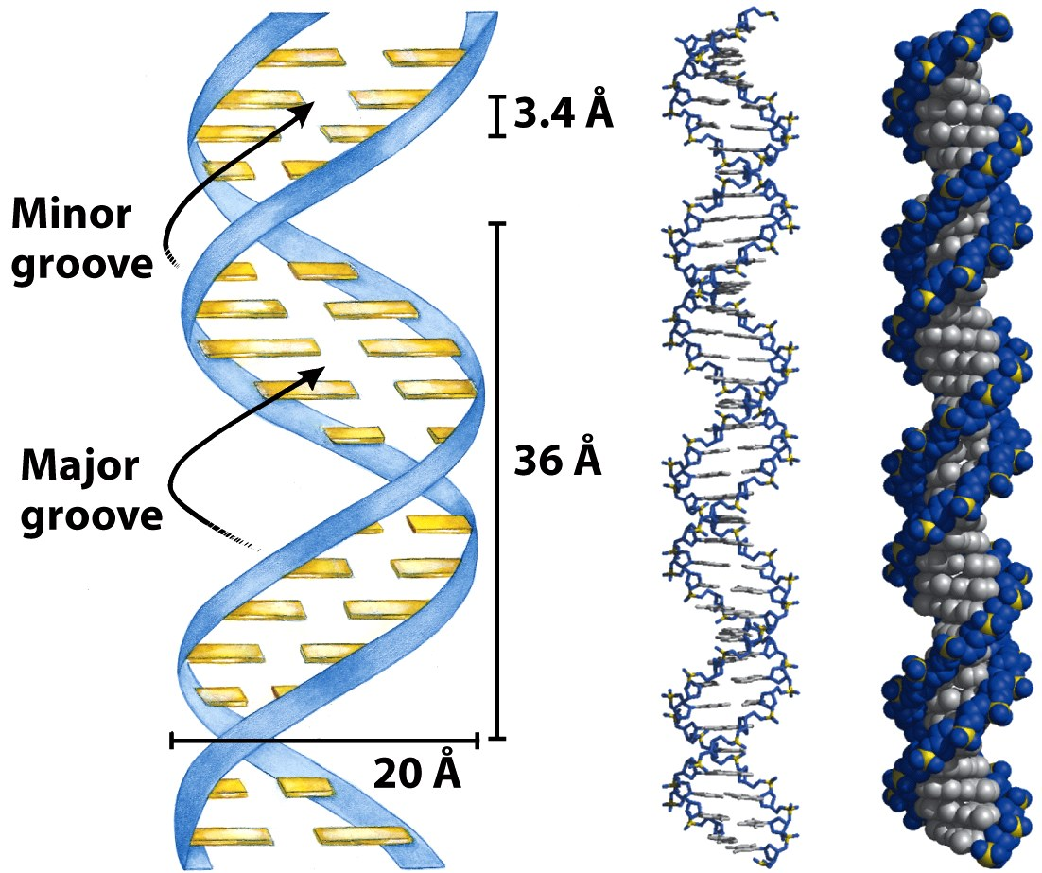
DNA is a double helix
34
34
Most DNA has a right-hand twist (B-DNA) with 10 base pairs in a complete turn

Slide 25
DNA Double Helix
“Rungs of ladder”
Nitrogenous
Base (A,T,G or C)
“Legs of ladder”
Phosphate &
Sugar Backbone

Slide 26
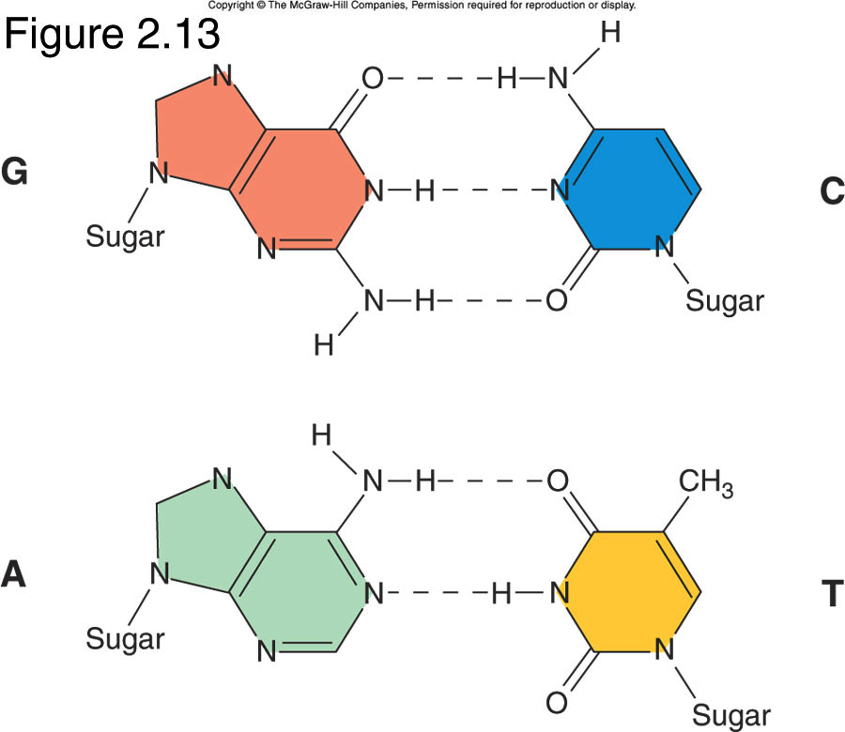
What chemical forces hold the DNA strands together?

Slide 27
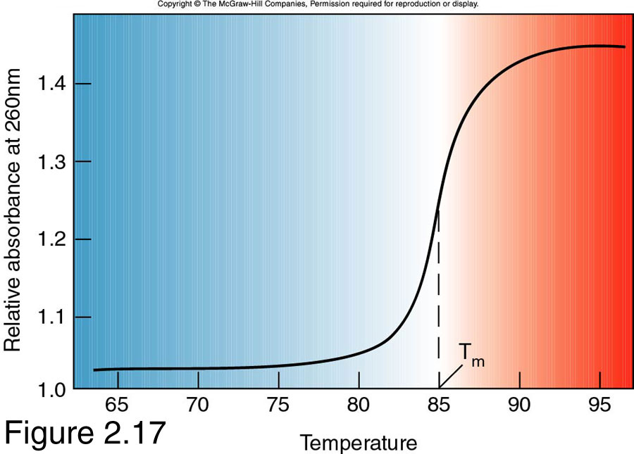
Study Helix Stability with Melting Curves
When a DNA solution is heated enough, The double-stranded DNA unwinds, and the Hydrogen bonds that hold the two strands together weaken and finally break. The process of breaking a double-stranded DNA into single strands is known as DNA denaturation, or DNA melting. The temperature at which the DNA strands are half denatured, meaning half double-stranded, half single-stranded, is called the melting temperature (Tm).
T_{m}= temp. at which 50% of DNA is melted.

Slide 30
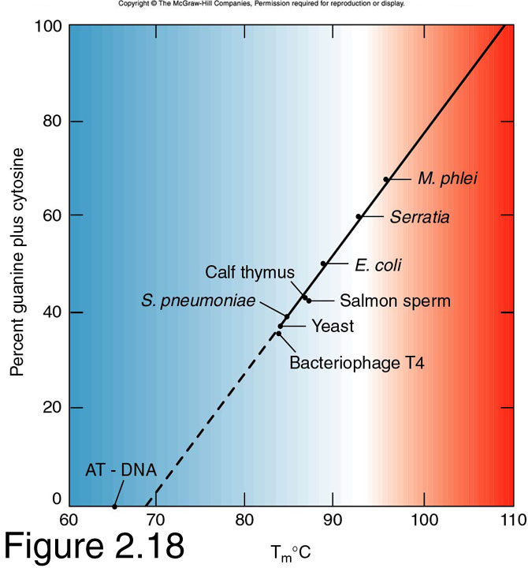
How to calculate Tm?
Tm = 2 X (A+T) + 4 X (G+C)
AATTTCTACGGCCA
No. of A&T = 8
No. of G&C = 6
Tm = 2*8+4*6; = 16+20; = 36
GGCGCAAACCCTA
No. of A&T = 5
No. of G&C = 8
Tm = 2*5+4*8; = 10+32; = 42
G-C content determines melting temperature

Slide 31
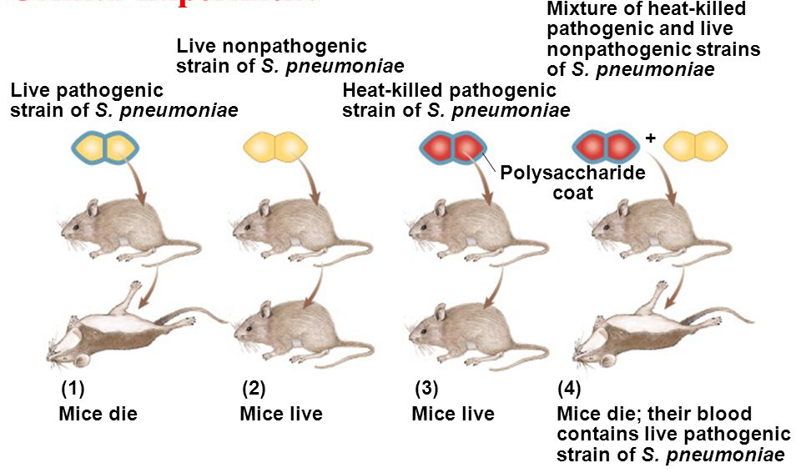
DNA - GENETIC MATERIAL
1. Griffith’s experiment- Transformation
Fred Griffith (1928) worked with virulent S and nonvirulent R strain Pneumoccocus bacteria
He found that R strain could become virulent when it took in DNA from heat-killed S strain
Study suggested that DNA was probably the genetic material
Griffith Experiment

Slide 32
2. Avery et al
Avery provided conclusive evidence that DNA is the heredity material for the bacterial specimens under investigation.
Oswald Avery (with his co-workers MacLeod and McCarty) characterized what they called the “transforming principle” from Griffith’s experiment.
They prepared a mixture of dead S Streptococcus and live R Streptococcus. (That Griffith had used).

Slide 33
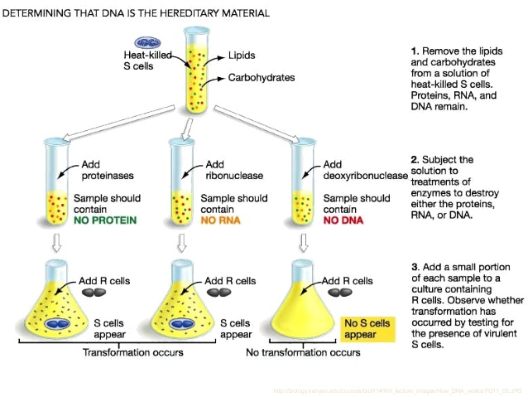
Avery Experiment: Conclusion
The researchers concluded that “a nucleic acid of the deoxyribose type is the fundamental unit of the transforming principle of Pneumococcus Type III” – basically:
DNA is the hereditary material for this bacterial species.
Avery’s Transformation Experiment - 1944

Slide 34
3. Hershey-Chase Experiment
Hershey and Chase provided further evidence that heredity material in bacteriophages was found in DNA, not in proteins.
Many did not accept Avery’s conclusions until 1952 when Alfred Hershey and Martha Chase conducted this experiment with bacteriophages (viruses that attack bacteria)
In the Hershey-Chase experiment, bacterial viruses called phage, were used to demonstrate that DNA is the genetic material. The phage used in this experiment consisted of a DNA molecule surrounded by a protein coat.
When phage infect bacteria, they attach to the surface of the bacterium and inject the DNA into the cell. The protein coat remains on the outside of the cell.

Slide 35
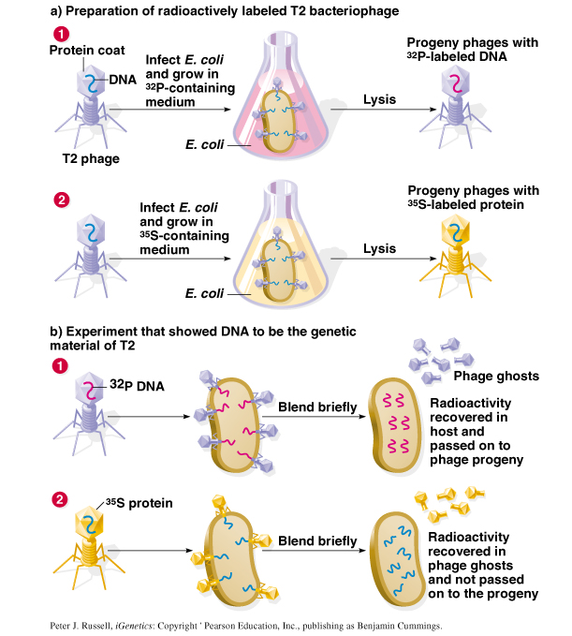
Hershey-Chase Bacteriophage Experiment - 1953
T2 bacteriophage is composed of DNA and proteins:
Set-up two replicates:
Label DNA with ³²P
Label Protein with ³⁵S
3. Infected E. coli bacteria with two types of labeled T2
4. ³²P is discovered within the bacteria and progeny phages, whereas ³⁵S is not found within the bacteria but released with phage ghosts.
This demonstrated that the DNA, but not the protein, carries the genetic information for a new generation of phage!

